Slide 1
kanban
Kanban is a framework that falls under the Agile methodology.
Kanban is one of the simplest frameworks used as it allows project managers to efficiently manage and keep track of their projects.
Kanban is a visual system for managing work as it moves through a process. Kanban visualizes both the process (the workflow) and the actual work passing through that process.
The goal of Kanban is to identify potential bottlenecks in your process and fix them, so work can flow through it cost-effectively at an optimal speed or throughput.
Kanban is a method for managing the creation of products with an emphasis on continual delivery while not overburdening the development team. Like Scrum, Kanban is a process designed to help teams work together more effectively.

Slide 2
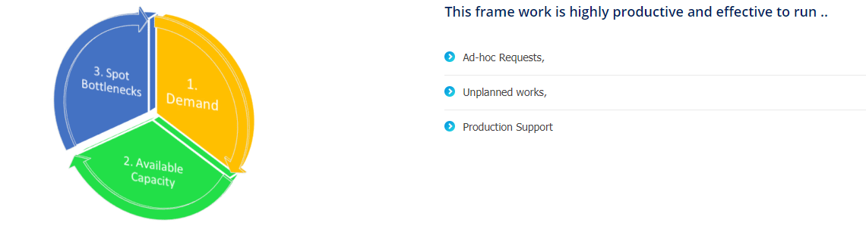
KANBAN Basics
Its a Method of Visualize the flow of work.
in order to balance demand with available capacity and spot bottlenecks

Slide 3
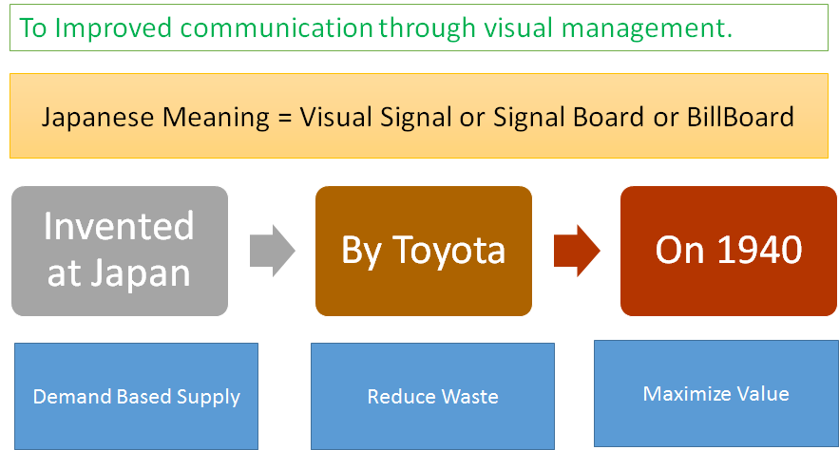
Kanban, also spelt kamban, is a Japanese term for “signboard” or “Billboard” that indicates “available capacity (to work)”. Kanban is a concept related to lean and just-in-time (JIT) production, where it is used as a scheduling system that tells you what to produce, when to produce it, and how much to produce.
Kanban became an effective tool to support running a production system as a whole, and an excellent way to promote improvement.

Slide 4
Principles
Implementing software increment on Kanban Method is a pull based system, that help the team to Continue the delivery in a sustainable pace, with in capacity. Its reduce waste of efforts and time. To Maintain this, It needs to follow the basic principles of Kanban as below.
Visualize Work
Visual model of Kanban Board of work and its workflow make the scope and capacity transparent, it helps to observe and Inspect the flow of work moving backlog to done. This makes the work visible—along with blockers, bottlenecks and queues and upcoming work, Which helps the team to make strategy of working on exiting work or bring new work to in Progress.
Limit Work in Progress
The Team mutually defines a Limit for all “work in progress” Columns in Kanban Board, such as Analysis, Development, Testing etc. This WIP limit implements the Pull based system, as work can be pulled to the current column from previous column only if the total number of work under the column is less than its limit.
This helps balance the flow-based approach so teams don’t start and commit to too much work at once. Its reduce waste and help the team to focusing on finishing first and starting later.
Focus on flow of Work
To Complete a work, and add a value it has to pass through multiple stages of its development phase. Like Analysis, Development, Testing , Review etc. To get the effective benefit of Kanban the Team needs to focus on flow of work from its initiation to completion. By following above 2 principles helps achieve focus on flow.
Focus on the workflow leads the team to visualize upcoming bottlenecks to act on. so that the flow remains. Team frequently makes strategy of working on in progress wor item to optimize the flow

Slide 5
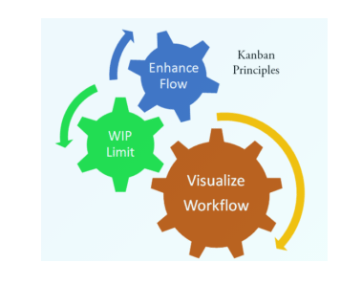

Slide 6
Kanban projects are primarily managed through a Kanban board, which segments tasks into three columns: “To Do,” “Doing,” and “Done.”
Kanban Framework focuses on visualizing the entire project on boards in order to increase project transparency and collaboration between team members.
This board plays a vital role in displaying the task workflow. It paints a picture of the workflow process, with an aim to identify any bottlenecks early on in the process, so that a higher quality product or service is delivered quickly.
In this method, work items are printed visually. It allows team members to see the state of every piece of work at every development stage. Moreover, a team member gets overview who's doing what and can identify and eliminate problem areas in the process.
It is a method for defining, managing and improving services for delivering work faster

Slide 7
i) How does Kanban work?
Kanban method revolves around the kanban board. It is a tool that visualizes the entire project to track the flow of their project. Through this graphical approach of Kanban boards, a new member or an external entity can understand what’s happening right now, tasks completed and future tasks.
The first step in the introduction of Kanban is to visualize the workflow. This is done in the form of a Kanban board consisting of a simple whiteboard and sticky notes or cards. Each card on the board represents a task.
Kanban board indicates:
the current tasks that are being performed
the tasks to do in the future
the tasks that are completed
The Kanban Method also follows a set of principles and practices for managing and improving the flow of work. It is an evolutionary, non-disruptive method that promotes gradual improvements to an organization’s processes.

Slide 8
ii) What is kanban board:-
It is a tool that visualizes the entire project to track the flow of their project
It helps to visualize the entire development process with a clear workflow which helps in managing ,tracking and improving the process .
It can be either physical (a whiteboard, sticky notes, and markers) or virtual (like Zenkit’s online project management tool), and can be used for personal productivity, as well as professional use.
The Kanban board is normally put up on a wall in the project room. The status and progress of the story development tasks is tracked visually on the Kanban board with flowing Kanban cards.
The Kanban board has columns and story cards. The columns are nothing, but workflow states and cards are nothing but a demonstration of the actual task a team member is performing.
In a classic Kanban board model, there are three columns, and these columns represent the status of the work. Each of these columns can have cards.
Column Represents The Work Stage Like As Shown Below;
“To Do”: This column lists the tasks that are not yet started.
“Doing”: Consists of the tasks that are in progress.
“Done”: Consists of the tasks that are completed
Other Columns Include Like Work Stage :
Development
testing

Slide 9
Kanban cards:
The tasks and stories are represented by Kanban cards. The cards represent the actual work.
When we look at a card it depicts a work item/task in the work process.
Cards are usually used to communicate progress with your team, it represents information such as status, cycle time, and impending deadlines.
The current status of each task is known by displaying the cards in separate columns on the board.
These cards will have
Priority
Owner
Type
Due date
Each task moves from To Do to Doing and then to Done
The divided columns are interconnected and tasks are gradually pulled from the leftmost column (future tasks) to the rightmost column (completed tasks).
As all the Work items are represented visually on a kanban board, allowing team members to see the state of every piece of work at any time. all blockers and dependencies are immediately identified and resolved.

Slide 10
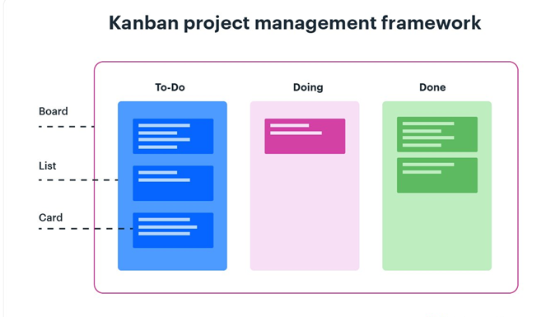

Slide 11
Kanban system measures the work cycle being completed through the principle of Work in Progress (WIP). WIP has certain limits and a pre-defined specific status.
WIP Limit:
you can place a WIP (Work in Progress) limit on the column. The WIP limit means the maximum number of cards that can stay on that column.
The label in the Doing column also contains a number, which represents the maximum number of tasks that can be in that column at any point of time. i.e., the number associated with the Doing column is the WIP (Work-In-Progress) Limit.
cards <=the WIP limit (The cards represent the actual work).
You can use positive numbers to limit work-in-progress, and this limit number can be placed on the top of the columns in both physical and digital Kanban boards. Any individual of the team can manage the state of his card, and the entire team can visualize the workflow.
Limiting WIP in order to maintain consistent standards is one of the core principles that govern the Kanban methodology in Agile. It is extremely important for the team to complete the current tasks in the prescribed order

Slide 12
As Kanban focuses on breaking down work into small tasks, visualizing them, and getting few items in any given work state.
In the Kanban board, work always moves from left to right. And, you pick work from the column to your left when you have completed all your existing work items or when an urgent task surfaces.
. This helps in increasing visibility teams as the teams can see the progress through every stage of development and prepare for the upcoming tasks to deliver the product “just in time”!
As the development evolves, the information contained in the table changes, and when a new task comes into play, a new “card” is created.
The Kanban method requires communication and transparency so that the members of a team can know exactly at what stage the development is and can see the status of the project at any time. visualize and examine specific parts of the workflow to identify bottlenecks in order to remove them.
Kanban Board is updated on a daily basis as the team progresses through the development

Slide 13
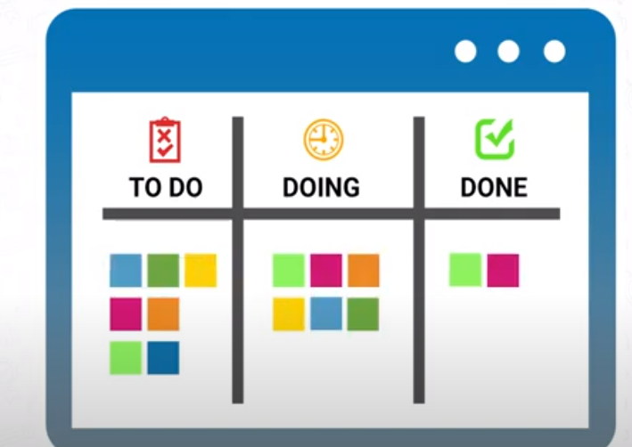
Kanban Board
A Kanban Board typically have three main Sections
Todo (or the Backlog)
In Progress (The Work in Progress Area)
Done (The Stories those are completed.

Slide 14
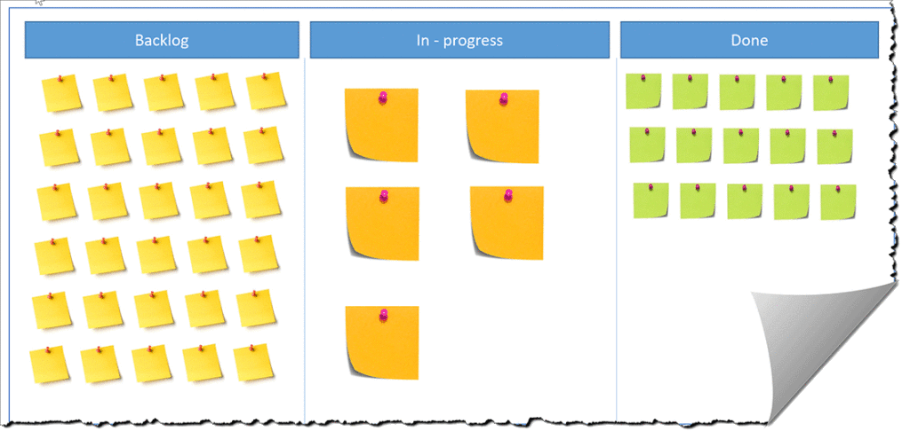

Slide 15
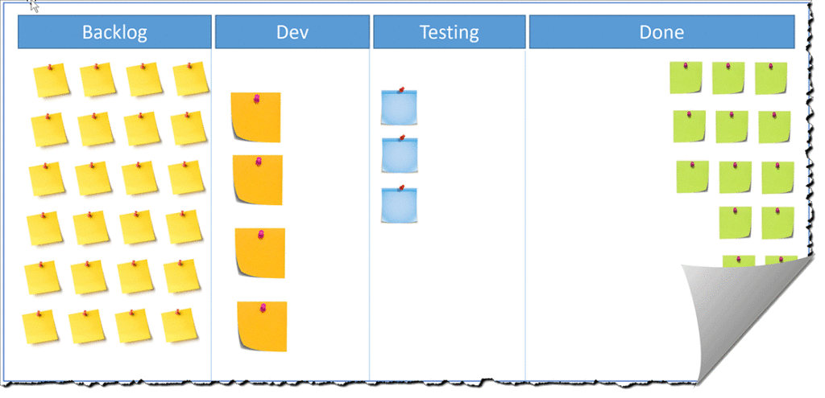
Implementing Multiple WIP Columns
How ever to make the distribution of work, we normally distribute the In Progress work into multiple columns
For Example, We can have Analysis, Development, Testing etc. In the picture on the right we have distributed the In Progress work into two section Development and Testing.
You can make the distribution as per your need and teams comfort to have a better control. This Distribution to more than one column always helps implement the WIP Limit for different skillset.

Slide 16
Implementing WIP Limits
Limiting the count of Stories for Work in Progress Column is one of the core principle of Kanban.
By implementing the WIP Limit, you will enforce the team to focus on the flow of stories from Left to right.
In this example we have limited the number of max stories in Development as 4 and max stories for testing is 3. That means the team can work on max of 4 stories under development column and max of three stories under testing column.
This Limitation will help the team to focus on finishing the stories first and then think about new stories to in progress.
For the image below we can see there are already 4 stories on development with limit of 4 and 3 stories under testing with limit of 3.
So in this case even the developer completes the development of 1 or more stories, They can not pick new stories from Backlog, as there are no room for new story or task under development.
To make room on development column testers need to pull one or more stories or tasks from Dev to testing. and the Tester can only do that, if the complete the testing of some existing story/task and move it to done state.
In this scenario the Developer will not seat Ideal. The will contribute their efforts to tester and expedite the testing so the team can pull stories from development, and developer can bring in new stories from Backlog.
The Team members can mutually decide the WIP limit at the beginning based on the team size and available skill set. And this Limit is subject to revise after certain period of time.

Slide 17
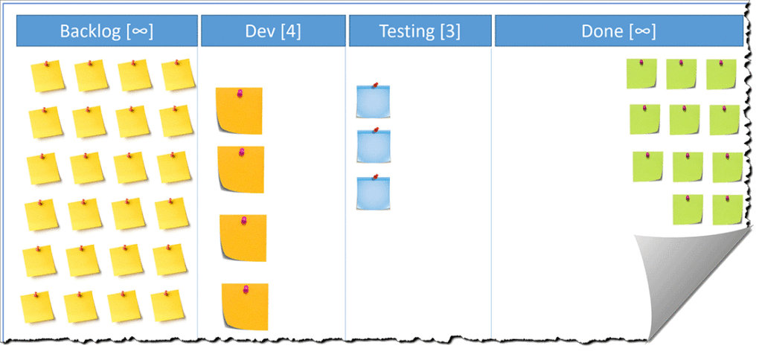

Slide 18
Kanban Uses A Pull Aproach:-
Pull approach is used as and when a task is completed in the Doing column. Another card is pulled from the To Do column.
THAT IS as Kanban project management uses a pull-based system, and when a developer is free, he/she can pull a card from the to-do column to the dev column to develop that.
A key aspect of Kanban is to reduce the amount of multi-tasking that most teams and knowledge workers are prone to do and instead encourage them to “Stop Starting! And Start Finishing. THE WIP – Work-in-Progress – Limits defined at each stage of the workflow on a Kanban board encourage team members to finish work at hand and only then, take up the next piece of work.
Therefore using Kanban board we can :
Provides easy access to everyone involved in the project.
Facilitates communication as and when necessary.
Progress of the tasks are visually displayed.
Bottlenecks are visible as soon as they occur.

Slide 19
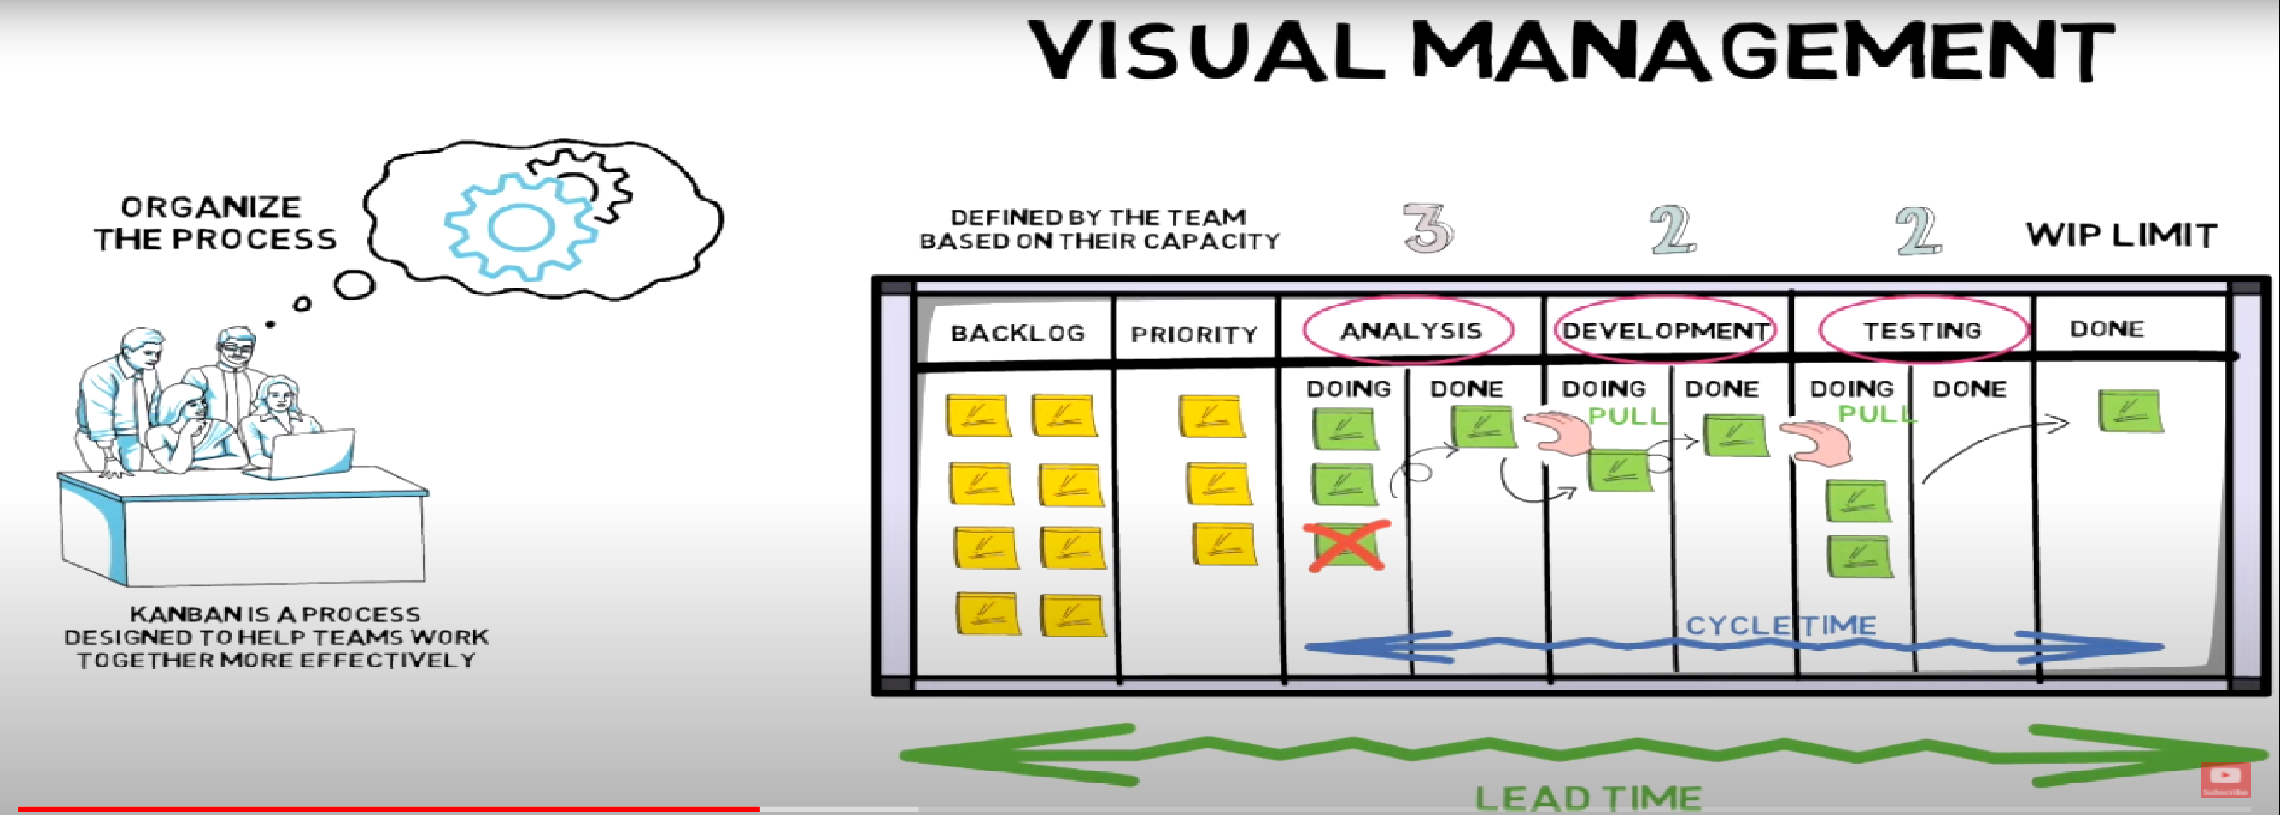

Slide 20
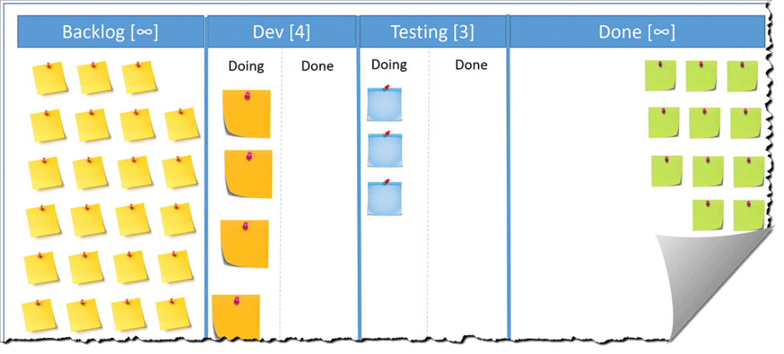
Split the WIP Columns.
Its always a good practice of splitting the WIP Limit by two areas
1. Doing 2. Done
This split will make the status of WIP more visible and prominent. And help the team to make their strategy. Done state of the Left column is the backlog for right column.
For Example, The stories under done state of Development are the backlog for testing.

Slide 21
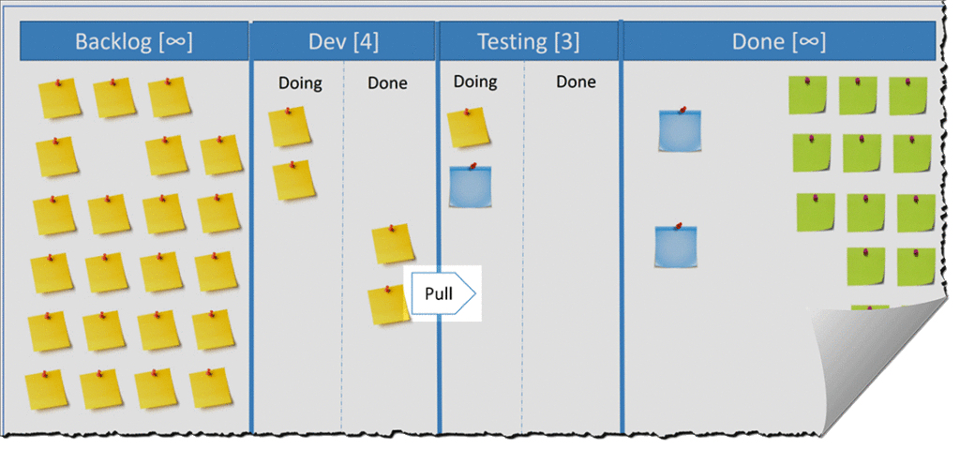
Understanding the Pull Based System
As we discussed earlier, Kanban is a pull based System. Implementing the WIP Limit, active the Pull based system. That means Thew team pulls a new task to its WIP column based on its current tasks and limits.
Even there are rooms in the current column, the team decide to pull a new story/task or finish the existing stories or task in the column.
The below three picture demonstrate three scenario, where the developer or tester have the opportunity can pull new story or task.

Slide 22
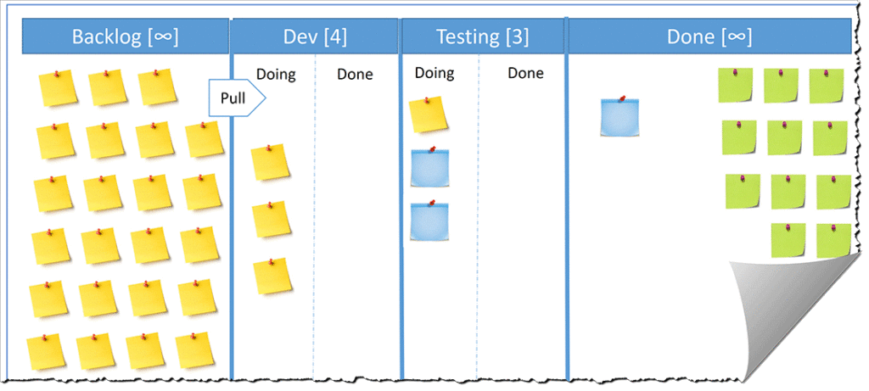
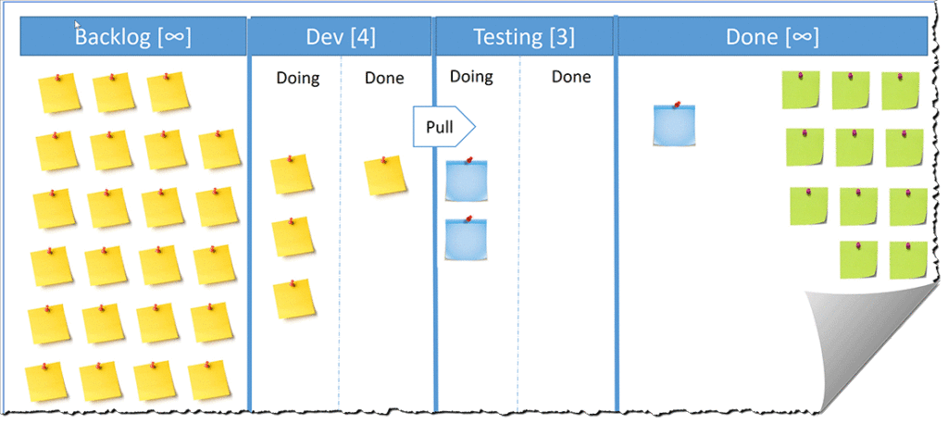

Slide 23
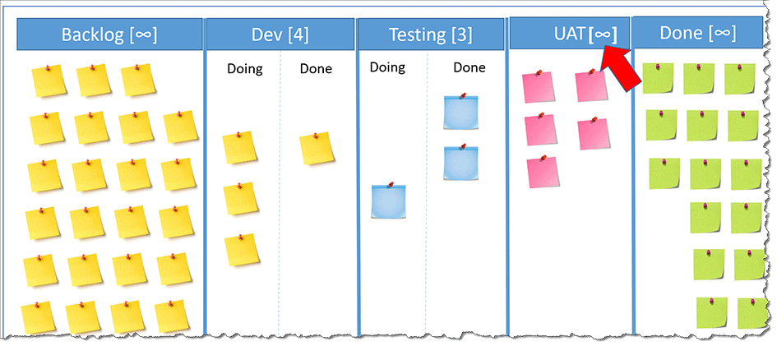
Working with Beyond Control WIP
So far we have talked about Work in Progress like Analysis, Development , testing etc. The execution under this column is always controlled by the Kanban Team.
However Sometimes the team wanted to have a column for other purpose , before moving it to done, for an example UAT.
The work under this UAT column may not be controlled by the team, as the task or stories has to be executed by end customer or client.
If we implement a WIP limit for this UAT column, it will become a bottle neck for the team, as the stories from UAT to next column may take times, depend upon customer’s other priority of work and available time.
To overcome from this situation of bottleneck, we set the limit of columns like UAT to infinite. to allow the task’s free flow to this column

Slide 24
Policies or Exit Criteria
If you have earlier worked on Scrum, you must be familiar with definition of ready. which is a checklist we use to review our story before marking it as “Done”.
For Kanban we use a similar concept, that we call as policies or exit criteria. and instead of having it at only before done. We prepare the exit criteria for all the done sate with in each work in progress.
As each WIP columns have two sections of “Doing” and “Done”. we implement the gate for each story from doing to done.
So we will have a policies of Analysis done, another policy for Dev done , and another for Testing Done.
The example for a Dev Done could be
All code has to be reviewed, and Review Comments should have uploaded in some repository
All code has to be checked in and Merged with QA branch
the Latest code should have deployed to QA environment.
x person should have notified by email.
Unit test result should have updated to somewhere.
etc.
The Team member mutually decide the policies for optimize the work and performance and and subject to revise after certain period of time.

Slide 25
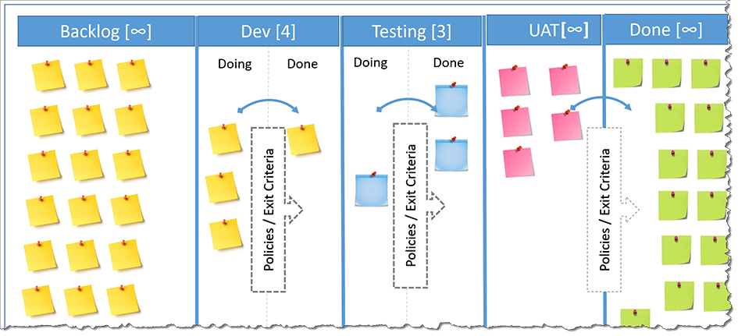

Slide 26
Expedite Lane(RUSH)
During our Regular work and priority we often responsible and accountable for resolving production support issues with different severity. and many other high priority activity comes in our plate from management with immediate resolution.
To work on those high priority work by overriding the WIP limit, we keep a reserved Swim lane for all those kind of work. and we call it as Expedite Lane or Priority Lane. And reserve a number of tasks for that lane on top of each column.
In this example here, our Expedite lane can add 2 more tasks on top of the WIP limit of each columns. So even the Dev limit is 4 and the developers are already working on 4 stories, They can still pick addition two stories if any stories can classify as High priority or eligible to work on expedite base.
Depends upon the frequency of those high priority tickets, issues, Tasks, Stories the team member can define the additional limit of Expedite Lane. and that Limit is again subject to revise in future.
The Team can prepare a definition of eligibility to treat a work item as priority work. and classify the work as priority item accordingly.

Slide 27
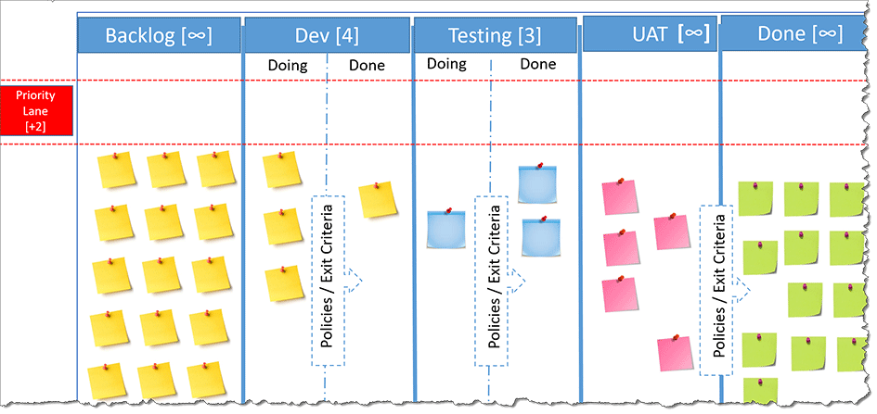

Slide 28
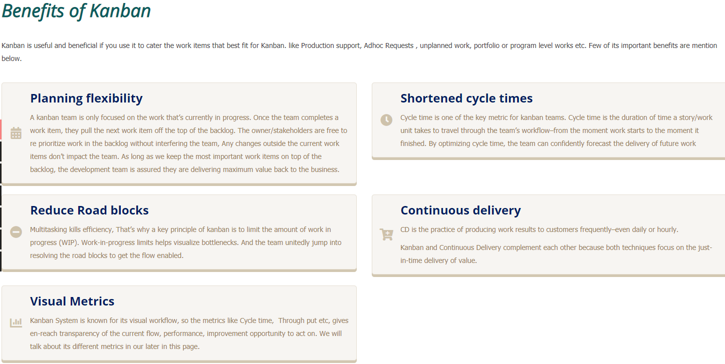

Slide 29
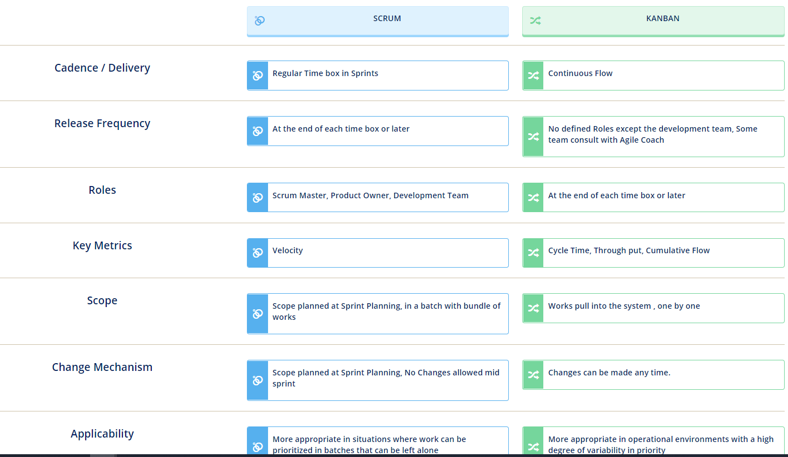

Slide 30
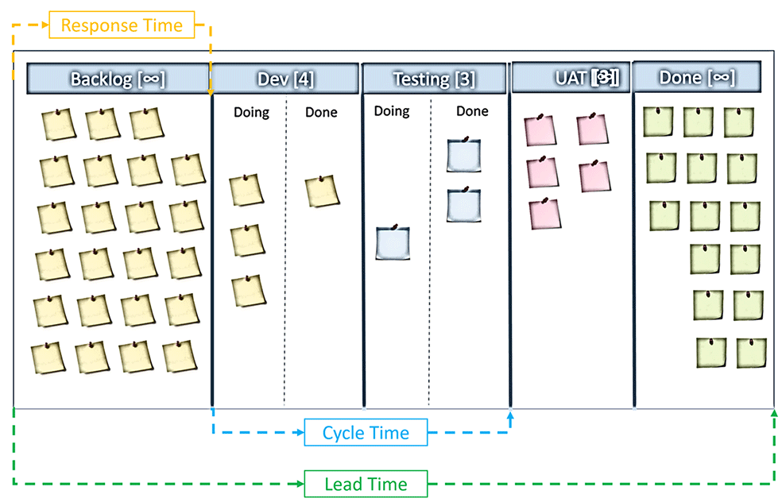

Slide 31
Kanban Metrics
Cycle Time
When your stories or work items travels on kanban flow, from first stage to last stage, its flows through multiple stage. Its stays with in one stage for a longer time or Shorter time.
We calculate the cycle time of a story by calculating the time between its entered the first WIP column. and leave the last WIP column in control (UAT is treated as Out of control WIP). It should be calculated based on the team spent actually working on this item, not how much time it was on the board.
In this example on right, the total time a story or work item spent in Development and Testing is the cycle time of the story.
Lead Time
This is similar to cycle time, but only difference is, its get calculated from when the work-item/story was created, or requested by the client and the time when it was delivered to the client. This time is also called as Customer lead time.
From the example on right, the lead time is getting calculated as the time between a story enters into the board and leave the UAT column (Done means delivered to Customer).
Response Time This is again calculated as the time a story/work item was waited on todo list. The time between it was created and got the first Response by moving it to in Progress.

Slide 32
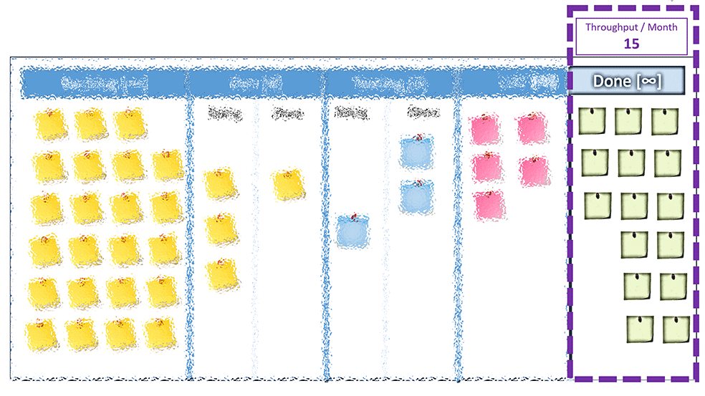
Throughput
Throughput is not that known measurement metrics. This metrics is number of stories completed in a given time frame, Week, Month etc. Completed means the stories/work-item completed or delivered to client. Its a real data, not on assumption or prediction.
Throughput is the number (count) of stories or work items that the team is capable to deliver in a given time period, e.g. week, month, provided that they keep a bearable work load.

Slide 33
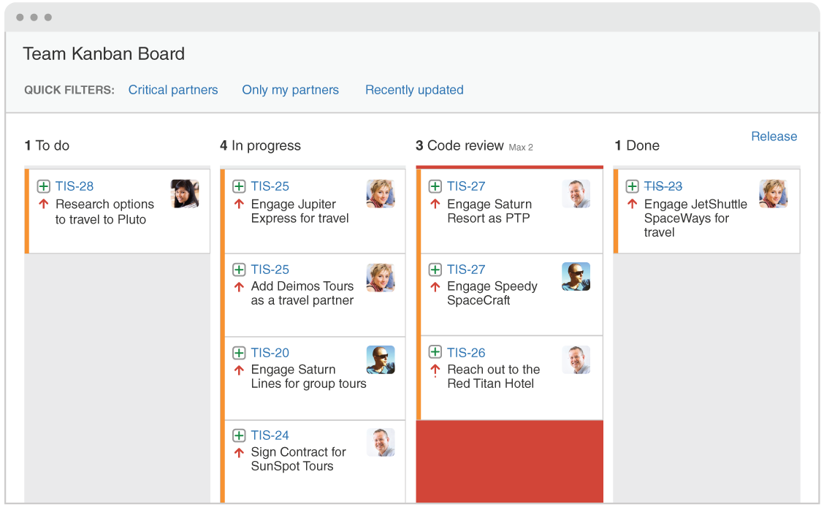

Slide 34
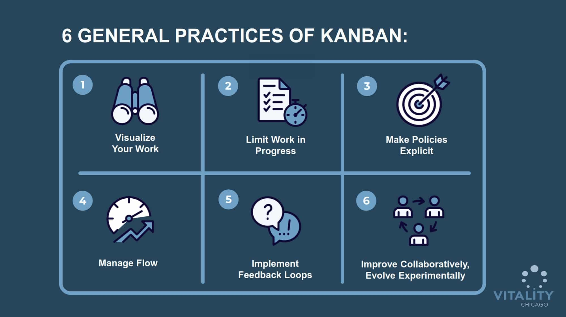
Kanban practices:-

Slide 35
1.Visualize the workflow:
This principle suggests having a Kanban board (physical or digital) to visualize the workflow. Each individual of a team must see his card and cards of other team members. You can move your cards in different columns as per your requirement. It brings lots of transparency within the team and also makes it easier to resolve blockers
2. Limit WIP (Work in Progress):
Limiting work-in-progress (WIP) is fundamental to implementing Kanban – a ‘Pull-system’. Setting maximum items per stage ensures that a card is only “pulled” into the next step when there is available capacity. Such constraints will quickly illuminate problem areas in your flow so you can identify and resolve them By limiting WIP, you encourage your team to complete work at hand first before taking up new work.
Thus, work currently in progress must be completed and marked done. This creates capacity in the system, so new work can be pulled in by the team. Initially, it may not be easy to decide what your WIP limits should be. In fact, you may start with no WIP limits.

Slide 36
3.Make Process Policies Explicit:
Policies can be established in a team to reduce the rework and focus on the areas which require attention or where it is more effective.
It is important for the project team to know what they are trying to achieve. The reason behind is quite simple, when someone has a clear goal in front of them, they’ll try harder to achieve it
By formulating explicit process guidelines, you create a common basis for all participants to understand how to do any type of work in the system. They can be a checklist of steps to be done for each work item-type, entry-exit criteria for each column, or anything at all that helps team members manage the flow of work on the board well. Examples of explicit policies include the definition of when a task is completed, the description of individual lanes or columns, who pulls when.
4.Managing the flow
One of the main goals when implementing a Kanban system is to create a smooth, healthy work flow
Managing the flow is about managing the work but not the people. By flow, we mean the movement of work items through the production process at a predictable and sustainable pace.
Instead of micro-managing people and trying to keep them busy all the time, you should focus on managing the work processes and understanding how to get that work faster through the system.
A Kanban system helps you manage flow by highlighting the various stages of the workflow and the status of work in each stage. Depending on how well the workflow is defined and WIP Limits are set, you will observe either a smooth flow within .
If there are interruptions or blockers, they must be fixed permanently. and make adjustments to improve flow so as to reduce the time it takes to complete each piece of work

Slide 37
5.implement Feedback Loops:
just delivering fast is not everything; delivering the right things is also important. To know this you need to know what the customers, the end users think, and how well the product contributes to your company's revenue and wellbeing. The need for getting feedback from people outside of your system. There is also a need for feedback loops within a system to make sure you deliver the expected functionality with the right quality. Here is where different kinds of tests come into the picture. Automated tests that run continuously are preferred since they make feedback loops shorter.
In Kanban, feedback is formalised and implemented not just within the team, but also between teams and between team members and their coach or manager.
make sure you get sufficient feedback from them on a regular basis. This feedback will not only help you optimize your system but also your product quality and the value you deliver.
6.Improve Collaboratively, Evolve Experimentally
This is the core principle of the Kanban system. It states that you can always improve the process, and that will result in better efficiency.
Any improvements you make to your system have to be done collaboratively. This is where your feedback loops come in handy.
You want to make changes to the system with your entire team. The team owns the system and has to work with it, so they have to support it. If only part of the team supports your system, it is less likely people will stick to its flow and its policies. The system has to be owned by the entire team.
The Kanban Method is an evolutionary improvement process. It helps you adopt small changes and improve gradually at a pace and size that your team can handle easily.

